Slide 1
EE4130 Seminar on
Requirements…
Prof. Joel Harris
CSULA – Electrical Engineering
February 7, 2018

Slide 2
Definition
A requirement is a statement that identifies a capability or function that is needed by a system in order to satisfy its customer’s needs.
A functional requirement defines what, how well and under what conditions one or more inputs must be converted into one or more outputs at the boundary in question in order to satisfy the customer’s needs.
A customer’s need might be to solve a problem, achieve an objective or satisfy a contract, standard or specification.

Slide 3
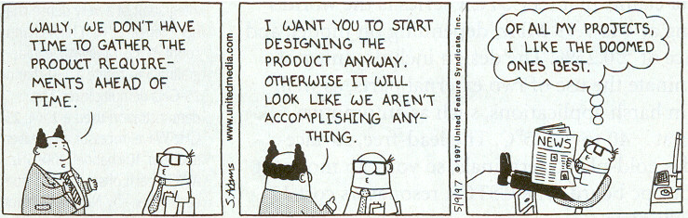
The 3 Systems Engineering Tasks
The three systems engineering tasks are
  Get the requirements
  Do the design
  Verify the requirements

Slide 4
System Requirements
No two systems are exactly alike in their requirements. However, there is a uniform and identifiable process for logically discovering the system requirements regardless of system purpose, size, or complexity.
Requirements emerge throughout the system life cycle. – They are not set in stone/fixed
Notes:
One of my boys once asked, "Daddy, Where does coal come from?'
He expected me to tell him about dinosaurs, and high pressure and stuff like that.
But I said "Coal doesn't come from anywhere, you have to dig it out of the ground."

Slide 5
Requirements Change
It is not possible to get all of the requirements correctly, up front.
Requirements are emergent.
Customers believe in the “I’ll know it when I see it,” maxim.
Stakeholder priorities change with time.
Once low-level requirements are satisfied, then other requirements become high priority.
Therefore, the process must be iterative.
Notes:
Maslow (1954) arranged personal needs in a hierarchy. Unsatisfied low-level (survival) needs have the highest priority. But after these needs are satisfied they become low priority and other needs become high priority.

Slide 6
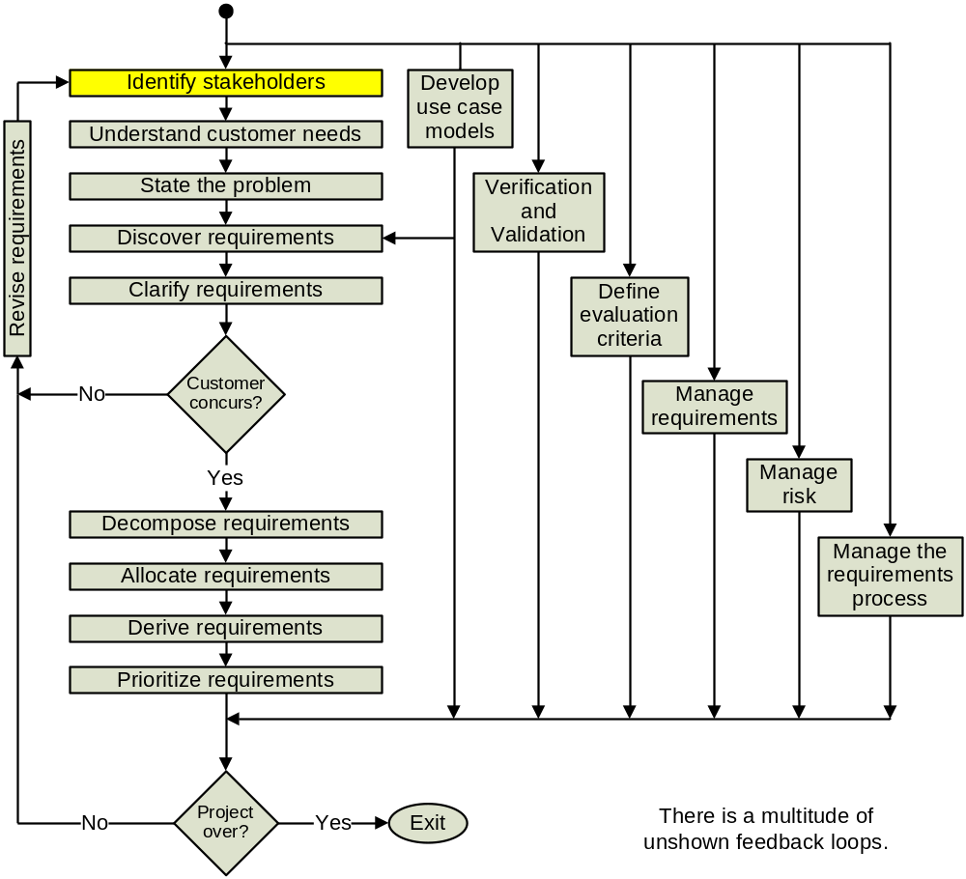
The Requirements Process
Notes:
There is a process that can be used to help find the requirements.
In this slide it looks like a serial process, but the real process is iterative with many unshown parallel activities and feedback loops.

Slide 7
Definition of “Stakeholder”
Stakeholders include all the people, organizations and institutions that are a part of the system environment because the system provides some benefit to them and they have an interest in the system. This includes end users, operators, bill payers, owners, regulatory agencies, victims, sponsors, maintainers, architects, managers, customers, surrogate customers, etc.
Notes:
A stakeholder is anyone who can drive a stake through your heart if you forget their pet project.
If you don’t have access to your customer, then you should create a surrogate customer. If you are building a system for the Navy,
then hire an ex-naval person (as Churchill phrased it) and have them go to appropriate conferences to keep up to date with changing Navy needs.

Slide 8
Understand Customer Needs
Customers are not aware of the details of what they need.
Systems Engineering must enter the customers environment, discover the details and explain them.
Flexible designs and rapid prototyping facilitate identification of customer needs.

Slide 9

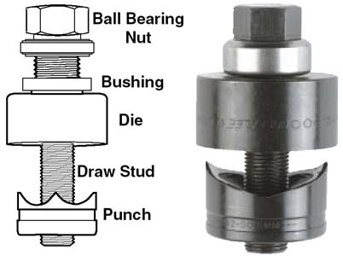
“Understand Customer Needs”
Usually, the customer misstates his needs.
Example: a person might walk into a hardware store and say he needs a three-quarter-inch drill bit.
But what he actually needs is a three-quarter-inch hole in a metal plate, and perhaps a chassis punch might do a better job.

Slide 10




The Top-Level Function
“The system shall hold together between 2 to 20 pieces of 8½ by 11 inch, 20 pound paper.”
Some alternative solutions:
  stapler
  paper clip
  fold the corner
  put the pages in a folder

Slide 11
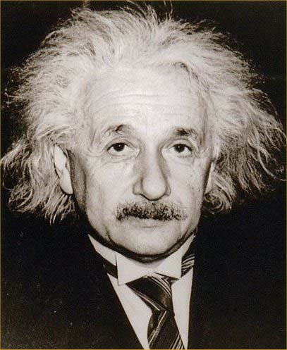
State the problem
When Einstein was asked what he would do if he had one hour to save the world, he replied that he would spend fifty-five minutes defining the problem, and five minutes finding the solution.

Slide 12
Understanding Requirements
During concept exploration, encourage consideration of bizarre alternatives. This will help you understand the requirements better.
Likewise, studying models and computer simulations will help you understand the requirements.
Understanding the requirements is one of the most fruitful phases in requirements discovery.

Slide 13
What Are Requirements?
Requirements are the statements that identify the essential needs of a system in order for it to satisfy customer needs and expectations.
No two systems are exactly alike in their requirements. However, there is a uniform and identifiable process for logically discovering the system requirements regardless of system purpose, size, or complexity.
Requirements emerge throughout the system life cycle.
Notes:
The little boy asks the sculptor
"How did you know that, that lion was in that rock?“
In the software community they call them requirement definitions and requirement specifications.
One of my boys once asked, "Daddy, Where does coal come from?'
He expected me to tell him about dinosaurs, and high pressure and stuff like that.
But I said "Coal doesn't come from anywhere, you have to dig it out of the ground."

Slide 14
References
© Terry Bahill, Department of Systems and Industrial Engineering, University of Arizona
A.T. Bahill and F. F. Dean, Discovering system requirements, in A. P. Sage and W. B. Rouse (Eds), Handbook of Systems Engineering and Management, 2nd Ed., John Wiley & Sons, 205-266, 2009.
Daniels, J. and Bahill, A. T., Hybrid Process Combines Traditional Requirements and Use Cases, Systems Engineering, 7(4):303-319, 2004.

Slide 15
Backup Charts

